Slide 1


SMART INDIA HACKATHON 2026
AI-Based Recommendation Engine
Problem statement ID :- SIH26108
Problem statement Title:- AI-Powered Recommendation Engine for Identifying Applicable Indian Standards for Procurement Specifications
Theme :- Smart Automation PS Category :- Software Team Name :- DevOrigin Team ID :-

Slide 2
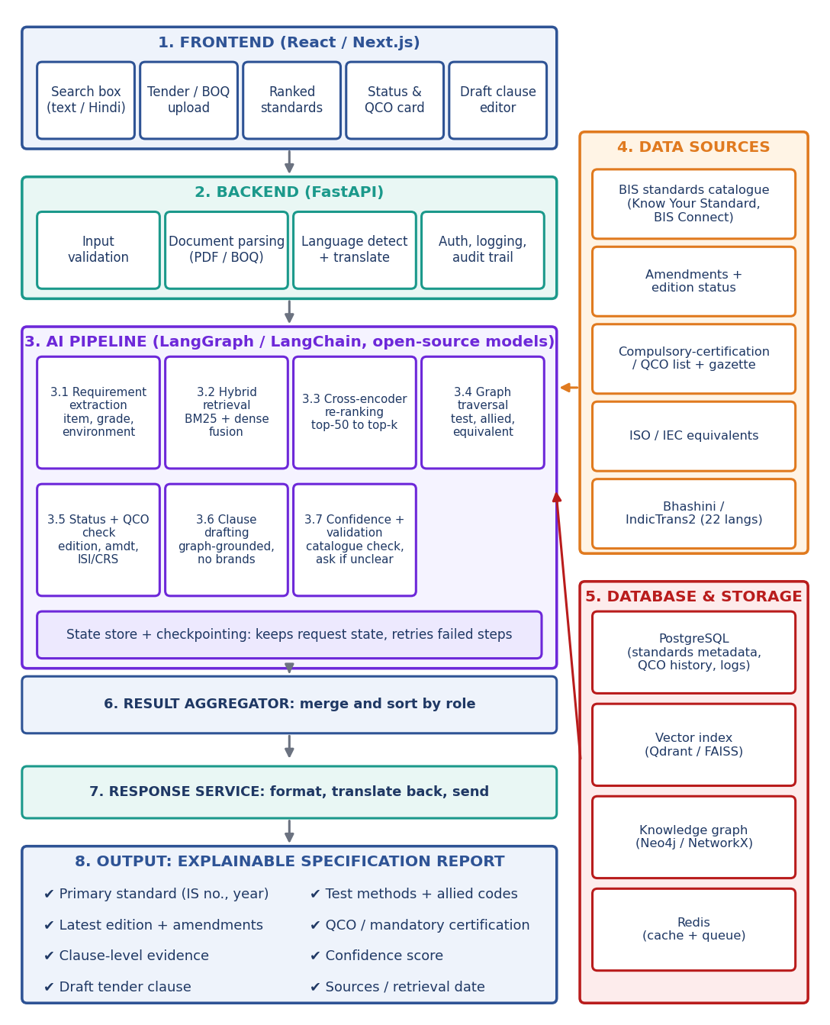

IDEA TITLE
DevOrigin
Proposed solution –
Dev Origin converts plain-language tender requirements into verified, current Indian Standards with certification requirements attached.
Accepts text, BOQ, or tender PDF — English or regional languages
Finds standards by meaning, not keyword — hybrid search + re-ranking
Returns the full standards family: product standard, test methods, allied codes, ISO/IEC equivalents
Flags latest edition and superseded/withdrawn standards
Checks mandatory certification: QCO, ISI mark, CRS, hallmarking
Every result is explainable: clause-level evidence, confidence score, sources
Validates every citation against the catalogue — blocks fake standard numbers
Drafts a GFR Rule 144-compliant clause; officer reviews and finalizes
Asks, doesn't guess, when key details are missing
Innovation and uniqueness:
Buyer-side, not bidder-side — prevents mistakes while drafting
Standards family, not a single answer
Live regulatory status — checked at query time
Built for India — BIS, QCOs, GFR, Indian languages

Slide 3

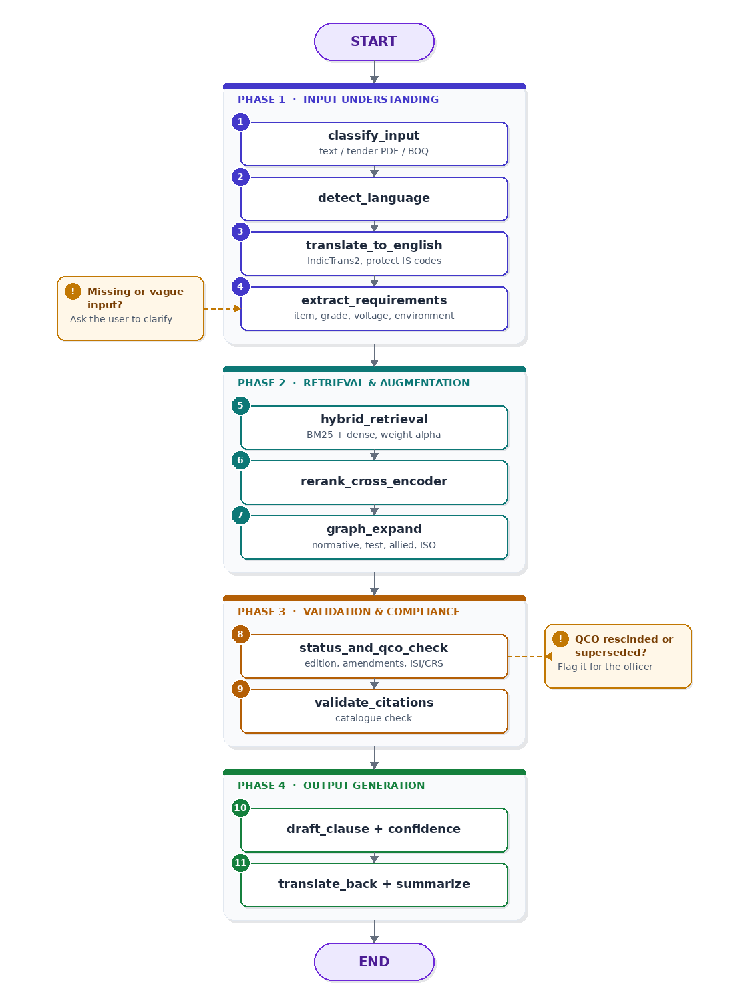
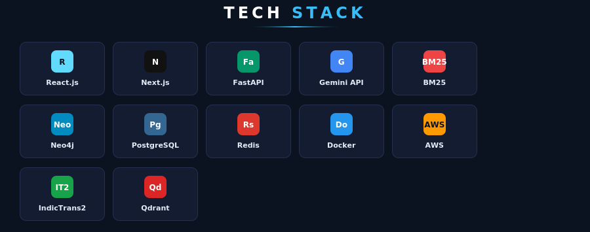
TECHNICAL APPROACH
DevOrigin
TECHNOLOGIES
Frontend: React.js, Next.js, Tailwind CSS, Recharts
Backend: FastAPI, REST API, microservices
Retrieval: BM25 + bge embeddings, cross-encoder re-ranker, IndicBERT
LLM: Gemini API / open-weight models (clause drafting only)
Knowledge graph: NetworkX (prototype), Neo4j (production)
Multilingual: IndicTrans2 / Bhashini API
Storage: PostgreSQL, Qdrant/FAISS, Redis
Cloud: Docker, GitHub Actions, AWS/Render, Nginx
Testing: pytest, Jest — NDCG@5, Recall@3

Slide 4

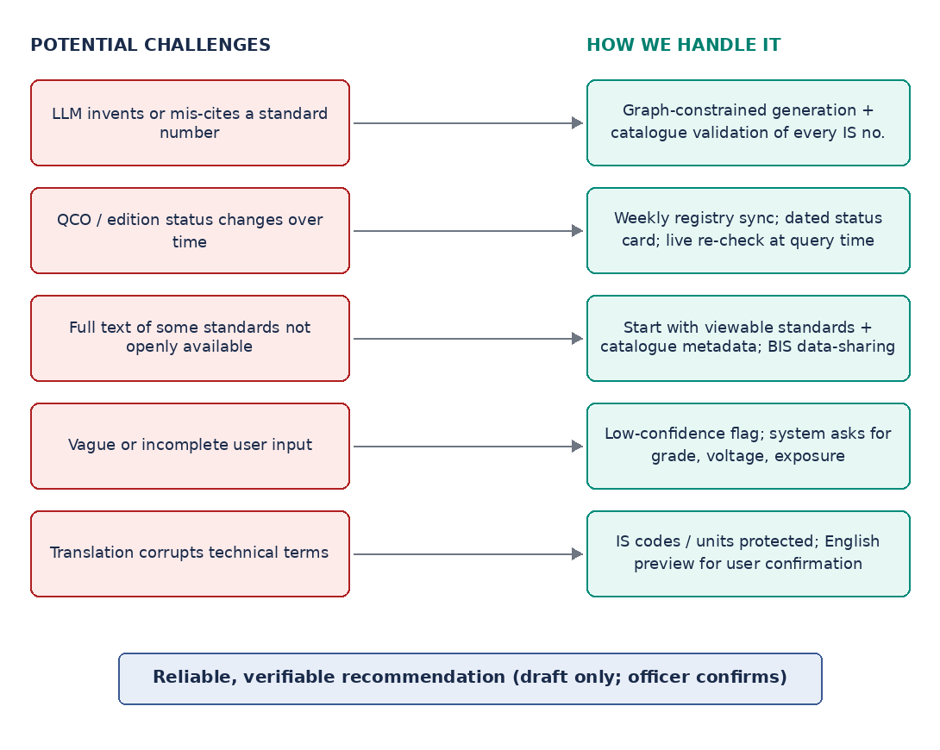
FEASIBILITY AND VIABILITY
DevOrigin
Practical: proven open-source tech; prototype covers 3 domains
Data available: BIS catalogue, amendments, gazette links
Reliable: checked against catalogue/graph, not model memory
Fits workflow: API inside GeM/CPPP — no new portal
Measurable: NDCG@5 ≥ 0.88, Recall@3 ≥ 0.95 (target)
Potential challenges → how we handle them:
Invented/mis-cited standard → graph-constrained generation + catalogue validation
QCO/edition changes → weekly sync, dated status, live re-check
Standard text not open → viewable standards + BIS data-sharing
Vague input → low-confidence flag, clarifying questions
Translation errors → IS codes/units protected
Over-reliance → draft only, officer confirms, audit log
Safe uncertainty handling: unclear cases marked "Needs human review."

Slide 5

IMPACT AND BENEFITS
DevOrigin
Benefits of the solution
Social: safer buildings/products (no missed test methods/certification); regional-language access for local bodies.
Economic: fewer tender disputes/re-tendering from incomplete specs; fairer competition via generic, brand-neutral clauses; easier MSME participation.
Environmental: less rework and rejected material when right standards are specified upfront (expected effect; to be measured).
Evidence-based recommendations instead of guesswork or copied templates.
Explains reasoning with clause-level evidence and a confidence score.
Always current: latest edition, amendments, and dated QCO status.
Saves time: one query replaces manual cross-referencing across standards, tests, and certification lists.
Complete: normative and allied standards included, so specs aren't left half-finished.
Transparent: audit log and printable justification note for the tender file.
Impact on target audience:
Procurement/tender-drafting officers (departments, PSUs, PWDs, Railways, Defence): write correct, current, complete specifications for items outside their expertise, faster.
MSMEs and bidders: see which standard/certification a tender expects in plain language, avoiding disqualification from confusing foreign vs. Indian standards. MSEs receive 68% of GeM orders (FY26).
GeM category managers/catalogue teams: get standards linked to categories and can spot tenders citing outdated/mismatched standards.
Vigilance officers and auditors: get an evidence trail and version history for why each standard was specified.
BIS and regulators: see wider, correct use of Indian Standards and QCO requirements in public buying.
End users/citizens: benefit from safer infrastructure and products since required tests/certifications reach the tender.

Slide 6

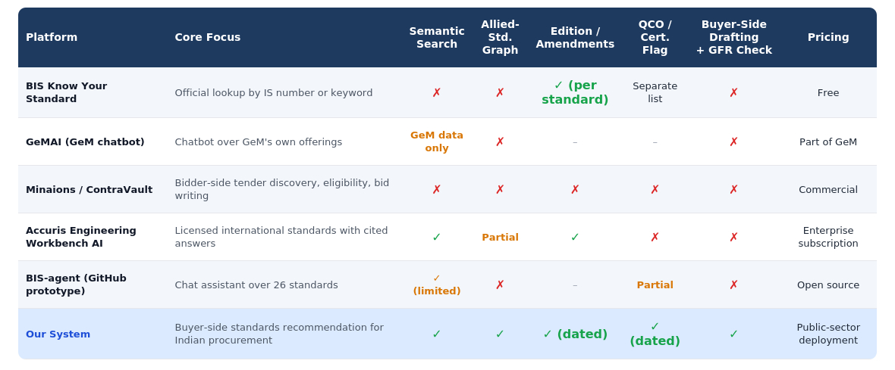
RESEARCH AND REFERENCES
DevOrigin
Research & References
Regulatory basis (GFR Rule 144): Manual for Procurement of Goods 2024
Standards and QCO data: PIB — 187 QCOs / 769 products; 22,689 standards in force
QCO changes over time: ThePrint — rollback of Quality Control Orders
Standards review cycle: BIS — process of setting standards
Worked example (IS 1786:2008): Test-method references in the standard's text
Lexical retrieval (BM25): Robertson & Zaragoza — The Probabilistic Relevance Framework: BM25 and Beyond
Dense retrieval: Sentence-BERT · BGE Embeddings (C-Pack)
Re-ranking: Passage Re-ranking with BERT
Retrieval-augmented generation: Lewis et al. — RAG for Knowledge-Intensive NLP
Graph-based RAG: From Local to Global: A Graph RAG Approach
Hybrid retrieval + re-ranking benchmarks: From BM25 to Corrective RAG (2026)
Citation-grounded hybrid + graph retrieval: Preventing LLM hallucination through hybrid retrieval and graph-augmented context
Multilingual translation: IndicTrans2 — 22 scheduled Indian languages (AI4Bharat)
Confidence calibration: Guo et al. — On Calibration of Modern Neural Networks
Comparison table

